Slide 1


Slide # | Content Overview | Time (mins)
2-3 | Welcome & Introduction | 5
4-7 | Connecting with our Members | 10
8-13 | Call Flow Enhancements | 25
14-18 | Authentication Updates | 15
19-21 | Why Being Human Matters | 5

Slide 2
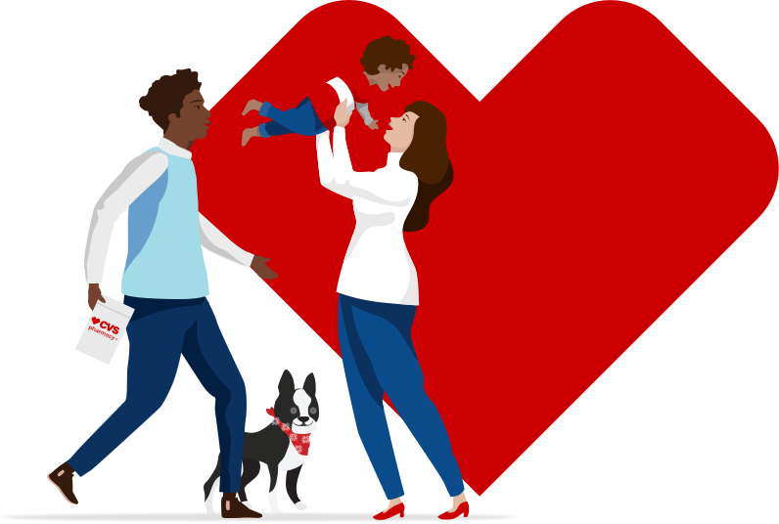

MEDD Universal CCF
Training
How We Care Q3.2023
Notes:
Time Allocation – 5 mins (slide 2-3)
Trainer Actions
Trainer to join the class 10 mins before it starts.
Greet attendees as they join, to trigger a subliminal being human foundational connection and mindset.
Lock the class after 5 min and begin; anyone who attempts to join after 5 mins must be rescheduled.
During the 5 mins, periodically ask attendees to open theSource; as a confirmation, ask attendees to use the raise hand emoji.
At 5 mins:
Advise if not already, to open theSource.
Ask to lower all hands.
Do not hold up the class for 100% confirmation – and begin the facilitation.

Slide 3




Connect
Consult
Protect
Be Human
Walk in our member shoes
Create member centric experiences
Safeguard and drive positive experiences
Understand Why Being Human matters
Notes:
Recommended Points
My name is (…) and welcome to our How We Care training series.
Our focus for today is to review our new “Medicare D Universal Consultative Call Flow” process.
This training will consist of four main stages:
Connect – with our members, by putting ourselves in their shoes.
Consult – review Call Flow enhancements to understand how we can best interact with our members and create memorable experiences.
Protect – talk through the Authentication process updates and understand why they make a difference.
To bring it all together, we’ll discuss why Being Human matters
Important Points
This learning experience is meant to be interactive; your thoughts and responses will 100% drive our discussion today.
After this training, the expectation is to immediately start adopting and following what we’ve learned today.

Slide 4
Connecting with our Members
Notes:
Time Allocation – 10 mins (slide 4-7)
Stage One – Connecting with our Members and understanding our impacts

Slide 5
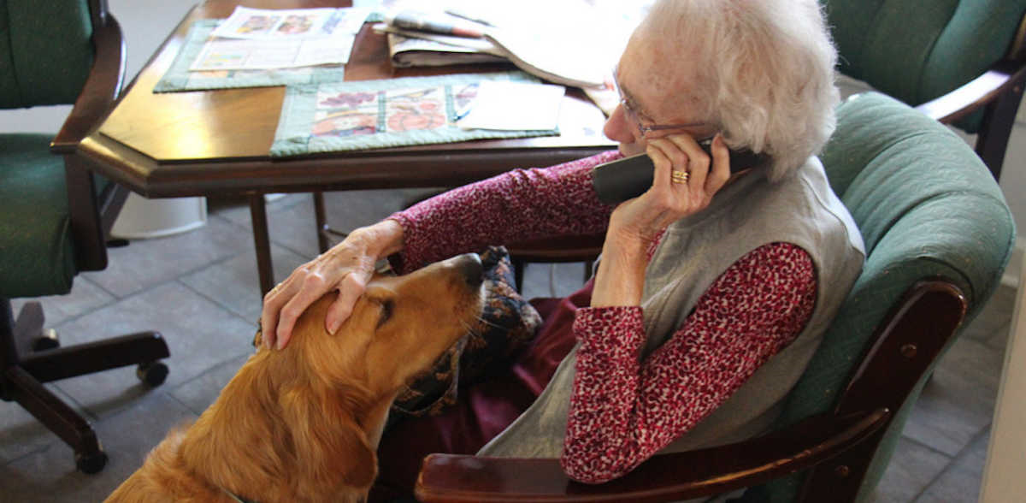
What are members feeling before they call us?
Notes:
Trainer Actions
Let’s begin by putting ourselves in the shoes of our members, using chat, what are they feeling – emotion wise – before they call us?
I’ll get us started. Trainer to put “Anxiety” into the chat.
Recognize and respond to responses (chat & verbal) as they come through.

Slide 6
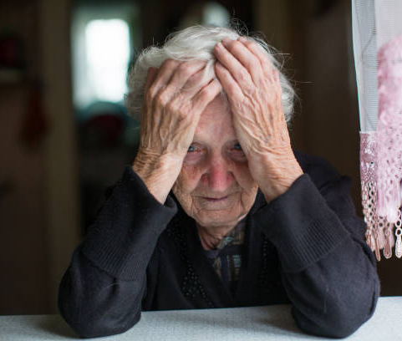
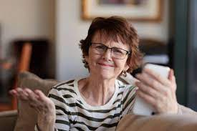
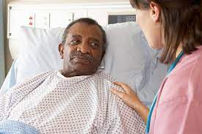



Notes:
Recommended Points
Its good to understand what members are feeling because every person has a backstory and the emotions they’re feeling are driven by their circumstances.
For our end, its always important to remember, members are people like each of us and they’re going through something and need our help.
To expand on your answers, we can all understand feeling (mention any not already stated)
Sadness
Lost & helpless
Anxiousness & uncertainty
Anger or frustration
Healthy & Happy
Sickness to grief
Smart and fully prepared to speak with you
Nobody understands me
No one truly see my situation

Slide 7
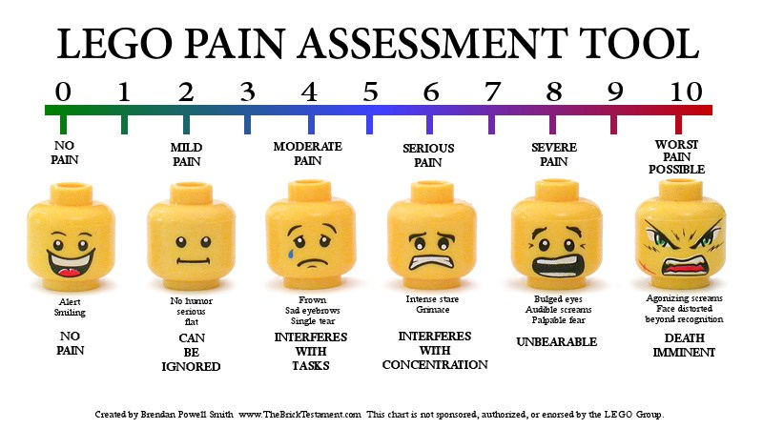
When Emotions Meets NPS Scores
Notes:
Recommended Points
When we say Hello is when a caller’s emotions meets NPS (Net Promoters Score) Scores.
For our end, it’s important to look at things this way:
Whatever they’re feeling, is valid and had nothing to do with me.
It’s my responsibility to help them as best I can.
During the call I will either relieve their stress or compound it.
The difference between a 0 to 10 experiences can often come down to:
Listening and talking to someone like a human being
Helping with spoken needs
Acknowledging emotions and situations
Showing empathy, timely and where applicable
Going above and beyond their spoken needs. For example, they say I’m out of refills and we advise you’re out…, you’re doctor needs to… – which quickly leads to, okay I’ll call them, end call – versus – to make it easier on you, I can get things started for you by submitting…
Recommended Points
For you, its important to mentally use a member’s verbal/emotional queues as a benchmark for how you’re managing and successfully moving someone through the emotions scale. .
As an example:
Okay (6) – is when you just do exactly what they asked for
Better (7-8) – is when you tack on acknowledging their emotions/situation
Best (9-10) – is when you:
Go above & beyond
Treat members as a human
Give members the experience they’ll remember as their bar for what good service means to them
Negative Experiences (1-5):
Is when we don’t or there is perception we didn’t really care or had any real interest in helping them
It could also be, even after doing all we could to help and talk someone through, some members stay unmoved, What matters is how much we tried.
WIFM Points (What’s In it For Me)
To make it easier for you and position you for success, we’ve created a Universal CCF/Authentication model.
This model creates 100% consistency for everyone under MEDD (PDP, Aetna, EGWP, HP & NEJE).

Slide 8
Call Flow Enhancements
Notes:
Time Allocation – 25 mins (slide 8-13)
Stage Two – review the Call Flow enhancements and understand how they improve member/caller experiences

Slide 9

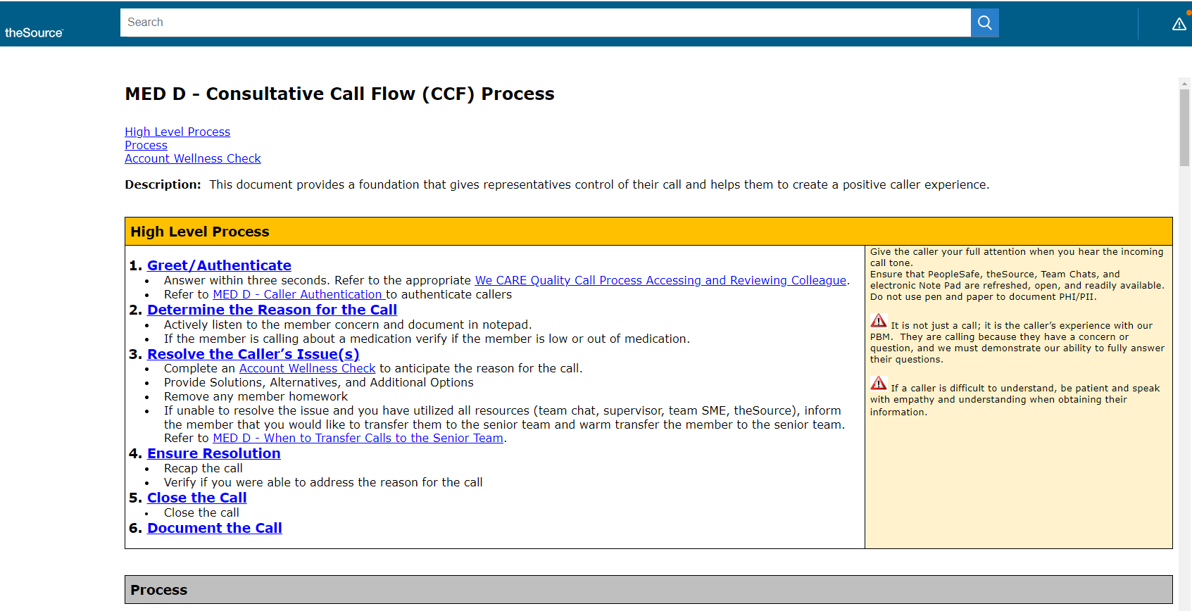
theSource Search
Notes:
Recommended Points
Direct the class to open theSource
Advise the WIs we’ll review today, are not searchable to ensure people get trained on them first. This will change after the majority are accounted for.
Provide guidance on accessing hidden work instructions:
Open theSource
Click the link to open in a new tab OR open a new tab and copy/paste the link
Auth WI link – https://thesource.cvshealth.com/nuxeo/thesource/#!/view?docid=d5c13330-c54c-41d0-871a-b74491b58f2d
Attendees to bookmark the page for future/return reference
Request to not share the links; everyone will receive when they’re trained
Trainer Actions
Have the page preloaded to easily transition to the review
Advise:
We’ll be covering two new work instructions today
Since we’re bringing everyone together under MEDD, all changes will fall under three buckets: (1) completely new to everyone, (2) new to some/reminder for others, and (3) things we changed/evolved to create an improved experience or outcome
Start by showing the High-Level process table and advise it’s a quick reference summary for all major steps within
Review the updates in groupings:
1 & 1B
2
4
5 & 6
After each grouping, show the associated slide and engage the class via chat for their thoughts
Affirm answers provided and/or provide the recommended points to trigger conversation or to round out the class responses

Slide 10

How do these changes improve member experience?
CCF Changes #1
Step 1
From – to ensure I’m in the right account
Change – to protect your privacy
Step 1B
Change – confirm email/phone and update messaging preferences
Notes:
Trainer Actions – Review the updates:
Show the High-Level process table and advise it’s a quick reference summary for all major steps within
Changes #1 – Go to Step 1 (Greeting & Authenticate). Two places:
Not CTI/IVR Authenticated or Partially Authenticated & Calling for Self / Power of Attorney
Not CTI/IVR Authenticated or Partially Authenticated & Calling in for Someone Else
From – To ensure I’m in the right account…
Changed To – To protect the privacy of your account…
Other Changes – call opening now only includes “Thank you for calling…” for all CTI authenticated situations
Changes #2 – Go to Step 1B:
Flow – Mobile & Email check was moved up, from right before the call ended to the beginning as part of the call start activities,
Changes:
Instead of if missing, we now always check for this information (i.e., confirm the information on file or if it’s missing) and/or PeopleSafe alerts which advise not to request email.
If incorrect or missing and no alerts, request the information and enroll the member into Messaging Preferences (MP)
Add clarity for handling when this information is on file, but the member is not enrolled in MP
Trainer Actions
Using chat, how do these changes improve member experience?
Look for a mix of answers, but ensure all points are accounted for. When not, engage the class for more.
Recognize and respond to responses (chat & verbal) as they come through to engage the class
Recommended Points
Avoid negative Member perception. Saying “to ensue I’m in the right place” may make the member feel a lack of confidence – how do you not know where you are and/or we haven’t even gotten into what matters to me yet – which could make them feel heightened stressed versus relieved or being taken care of.
Creates positive Member perception tied to telling someone you’re looking out for them.
Messaging Preferences opens up lines of communication directly with the member.
Messaging Preferences is something the member may not understand the full benefit of, but when they begin to use it, they’ll be thankful we did this for them.

Slide 11
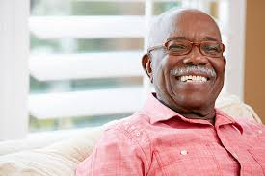
How do these changes improve member experience?
CCF Changes #2
Step 2
From – which medication are you calling…
Change – what can I help you with today?
Step 2
Moved – guidance for medication calls
New – determining days’ supply of medication on hand
New – handling repeat caller situations
Notes:
Trainer Actions – Review the updates:
Changes – Go to Step 2 (Determine the Reason for the Call)
From – Thank you, which medication are you calling about?
To – What can I help you with today?
Other Changes:
Create an if then table for:
Providing guidance for a member calling about a medication as the primary example
Expanded the If/Then table to include Repeat Caller Guidance, specifically for same issue situations
Checking for Medication on hand:
From – Are you low on medication
To – How many days’ supply of medication do you have
Trainer Actions
Using chat, how do these changes improve member experience?
Look for a mix of answers, but ensure all points are accounted for. When not, engage the class for more.
Recognize and respond to responses (chat & verbal) as they come through to engage the class
Recommended Points
Negative Member perception regarding:
You’re assuming the reason for their call. If not the reason, the call starts with them saying no, I’m really calling about…
Feeling the call is scripted and not personable
Positive Member perception tied to starting with a broader scope, how can I help you. This also drives the I’m here to help you mindset, which could reduce their potential stress.
NPS/OSAT results tell us members can become quite frustrated with transfers.
Moving Repeat Callers up puts you in a position to determine if a senior handoff is needed upfront. IMPORTANT: when it's tied to repeat callers for the same situation,
Doing this check upfront alleviates potential stress tied to the member feeling they spent time with you, which is now time wasted because they must start all over again with something new.
Low is subjective, it could be two or 10 days. Using five specifically creates a clear distinction on the member’s situation.

Slide 12

How do these changes improve member experience?
CCF Changes #3
Step 4
Change – Recapping the call
Change – Reacting to, was I able to fully address your reason for calling today
Change – Senior handoffs if a situation is not resolved after two attempts
From – mentioning a survey will be sent
Change – survey is not mentioned
Notes:
Trainer Actions – Review the updates:
Mention – Go to Step 3 (advise section was cleaned up)
Changes – Go to Step 4 (Ensure Resolution):
Modified – Recap the Call now includes reason for the call (i.e., primary highlights of information provided, and actions taken for the member)
Note – DO NOT use jargon, instead use language a member can understand
Evolved/Moved Up:
Confirm was everything taken care of with – Was I able to fully address…
If yes, proceed to closing the call
If no, apologize and attempt to address anything missing or not fully clear
Handing off callers to the Senior Team ONLY when appropriate (i.e., if the member advises twice within step 4 that you have not resolved the reason for calling)
Removed all references to a survey being sent in the recap confirmation
Trainer Actions
Using chat, how do these changes improve member experience?
Look for a mix of answers, but ensure all points are accounted for. When not, engage the class for more.
Recognize and respond to responses (chat & verbal) as they come through to engage the class
Recommended Points
Positive Member perception tied to feeling fully heard and taken care of (i.e., confirm/acknowledge we met their spoken needs, using simple and easy to understand language)
Allows the member to raise any questions they might have
If anything was missed, the member can raise before the call ends
Handing off to the Senior Team, when applicable removes the member from being stuck in the middle of any struggles a representative may be experiencing.
Missing something and needing to go back is not immediately a second attempt for handling, it’s still the first attempt.
Not all members receive surveys so saying it to everyone creates an unreal expectation for some members

Slide 13
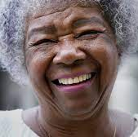
How do these changes improve member experience?
CCF Changes #4
Step 5
Change – more member centric closing
Step 6
New Step – documenting the account
Notes:
Trainer Actions – Review the updates:
Change #1 – Go To Step 5 (Closing):
Provide members with a more member centric & positive closing statement. Be mindful and adjust accordingly when not appropriate (i.e., anger, stress or grief drove the call)
Change #2 – Go to Step 6 (Documenting the Call):
New step, with a direct link on the guidance to follow and expectations for documenting the account before closing out
Trainer Actions
Using chat, how do these changes improve member experience?
Look for a mix of answers, but ensure all points are accounted for. When not, engage the class for more.
Recognize and respond to responses (chat & verbal) as they come through to engage the class
Recommended Points
Positive member perception tied to a more pleasant closing response; not just for their call but saying have a great day projects positivity and friendliness.
Documenting the account assist with any future calls (i.e., if the member calls back for any reason, they do not have to repeat themselves or remember call specifics)

Slide 14
Authentication Process Enhancements
Notes:
Time Allocation – 15 mins (slide 14-18)
Stage Three – review the Authentication process enhancements and understand why they matter

Slide 15
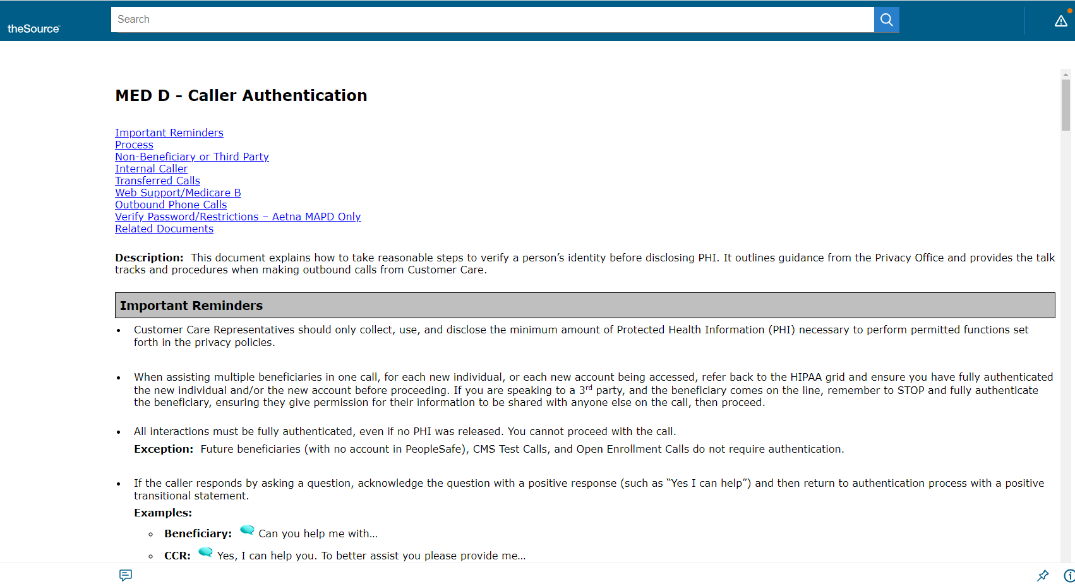
theSource Search
Notes:
Recommended Points
Advise the class we’re now transitioning to our second new work instruction
Advise we’ll follow the same steps as before to access this hidden work instruction:
Open theSource
Click the link to open in a new tab OR open a new tab and copy/paste the link
Auth WI link – https://thesource.cvshealth.com/nuxeo/thesource/#!/view?docid=908d53ec-df87-4db4-bb56-6d812e723dd6
Attendees to bookmark the page for future/return reference
Remind the class not to share the links; everyone will receive when they’re trained
Trainer Actions
Have the page preloaded to easily transition to the review
Before we get started, one of the top opportunities we’re finding is tied to not fully completing the Authentication process when necessary
Its important to always follow the Authentication and/or Third-Party Authentication process when:
Speaking directly to the Member
A person or business is calling on behalf of the member
During the conversation, a different member is raised, or you have a change in who you’re speaking to
Scroll to step 1, specifically the “Not CTI Authenticated Or Partially CTI Authenticated” section
Show the two updates:
2C
From – asking for a medication to authenticate
Changed To – asking for the Member ID to authenticate
2D
Change – zip code is now the fourth authenticator
Confirm – all other Authentication process steps & checks are unchanged
Trainer Actions
Using chat, how do these changes improve member experience?
Look for a mix of answers, but ensure all points are accounted for. When not, engage the class for more.
Recognize and respond to responses (chat & verbal) as they come through to engage the class
Recommended Points
Members are likely using their Member ID card to call us
Members may have to pause the exchange to go retrieve their medication bottle due to not knowing
Members may struggle with pronouncing their medication
If a member is feeling emotional, not being able to easily flow right into their intended scope could magnify what they’re feeling and validly so
Authenticating an account protects the member’s sensitive and personal information

Slide 16
Authentication Process & Experience Impacts
Scenario 1
Scenario 2
Ummm, can you help me?
Thanks for calling Caremark my name is ________? What’s your name?
Sam Smith. I don’t have anything. I’m totally out.
Weird I don’t have an account coming up for you. What’s your name again?
Sam S-M-I-T-H. What do you mean you can’t find me?
Sorry about that. What’s your date of birth?
1/1/1990.
Hmmmm. Oh, there you are. Can you confirm your Member ID & zip code?
Ummm, can you help me?
Absolutely I can help you. We can solve anything together. Let’s start with your name and DOB. Then I can take a look at your account.
Sam Smith and my DOB is 1/1/1990
Thank you for that. I just need to confirm two more things, can I please have your Member ID and zip code?
My Member ID is xxxxxx and my zip code is 10001. I’m actually calling about my Atrovostatin. Which I am out of, along with three other medications. This is just awful!
Sam, you did the right thing by calling us today. Let me see what’s going on and how we can take care of you….
Notes:
Trainer Actions
Advise these scenarios are based on actual member call transcripts.
Ask the class to read both scenarios and to measure each between 0 (worse) to 10 (absolute best) in their minds.
Afterwards, using chat, which scenario is better and why?
Recognize and respond to responses (chat & verbal) as they come through.
Recommended Points – Scenario 2 is better because:
Sounds more human & conversational versus scripted, robotic or transactional
Rep is adjusting with the member and is evolving their responses based on how the conversation is going; however, they’re still hitting all needed authentication points
Rep is driving the flow of the call by how they’re, relating and reacting to the member throughout. As an opposite, in scenario 1, it’s the member who is driving the flow.
Rep is putting the member at ease by being empathetic to the member’s situation at each turn
Rep creates member confidence by fully taking ownership of the call
Rep puts the member at ease, as a response to the member expressing emotion regarding running out of their medications

Slide 17
Why Being Human Matters
Notes:
Time Allocation – 5 mins (slide 19-21)
Stage Four – to bring everything together we’ll discuss Why Being Human matters

Slide 18
Our purpose inspires us. Our behaviors guide us. Our actions define us.
Notes:
Recommended Actions
We’ve all had customer service experiences. It could’ve been you calling a business for help, going shopping or even just going out to eat somewhere.
In all these instances, some stand out as the worst ever, most were not bad but nothing special and soon forgotten.
However, everyone has some which leave a memorable impression and stay with you forever because they serve as your bar for what you think great service feels like.
For every person who calls and needs our help, always keep in mind what our Helping With Heart training taught us… read the slide bullets

Slide 19

Why Being Human Matters
Members are people who need my help
Emotions are driven by member circumstances
Excellent service is more than just completing a successful action request
Its important to follow the “Golden Rule” and treat members how I would want for myself
Universal CCF model benefits me because it creates consistency across all MEDD Lines of Businesses
Call Flow changes position me to provide a more member centric & positive experience
Notes:
Trainer Actions
Request for six volunteers to review the slide bullets. Note: adjust number of volunteers to engage, based on time remaining.
Remind the class:
You’re expected to immediately start adopting and following what we’ve learned today.
If not already, bookmark the two new (hidden) work instructions.
Advise we’ll socialize when the WIs are made searchable and formally replace the previous two CCF/Authentication work instructions.
Thank the class for their participation & engagement and wish them a great day.

